Slide 1
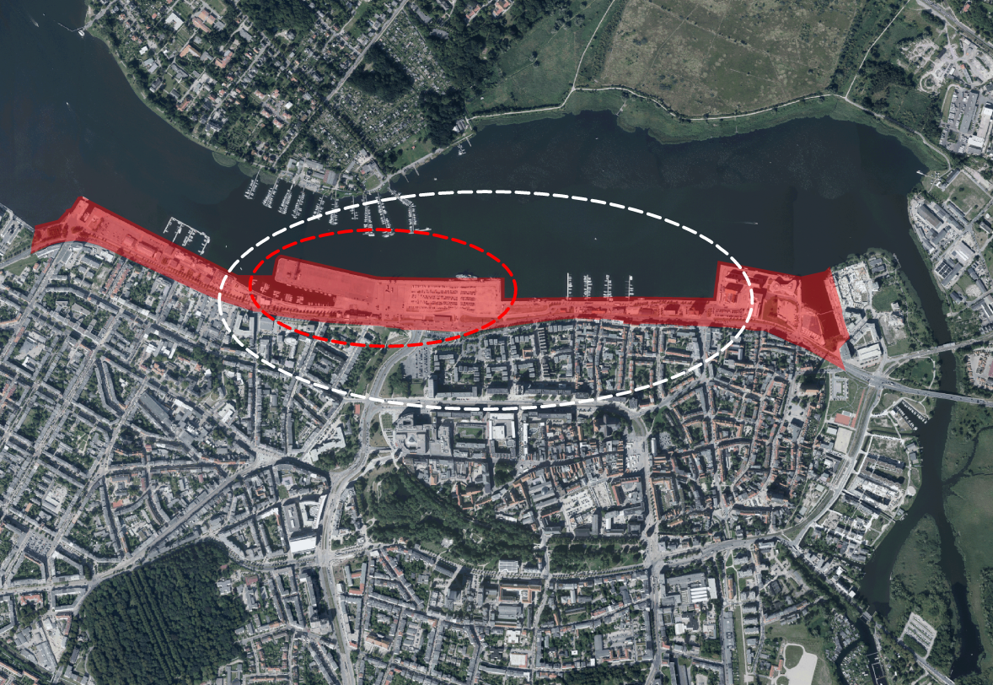
Urban planning & development process management
Workshop Micro Scale: central zone of city harbour
JOHANN 15.-17.05.2017
Workshop Rostock Package 1 – micro scale – central zone of city harbour

Slide 2
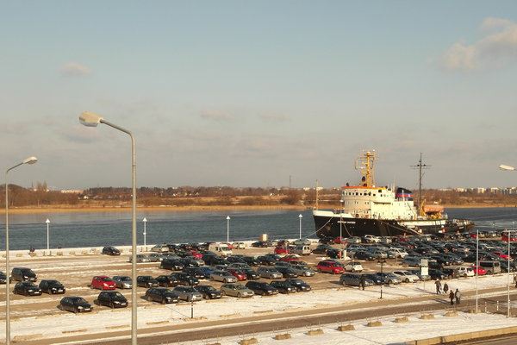
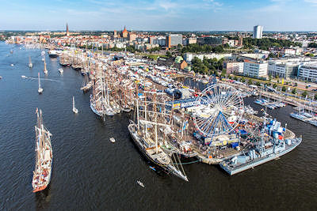
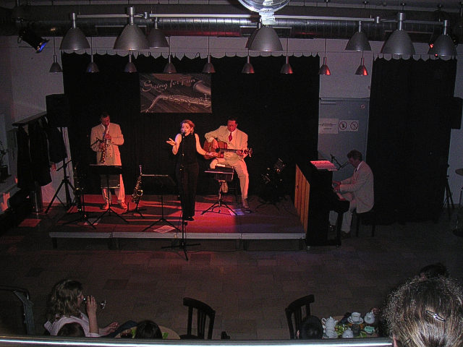
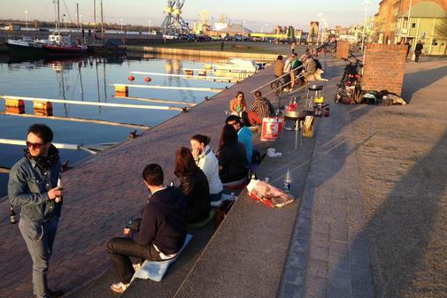
Used as parking area
– temporary character
– discharge function for city center
location of HanseSail
– event with more than
1 million visitors and 200 ships
– important economic factor for private economy
area for social life
– used as open air meeting point in the evening
– offers a varied cultural program
JOHANN 15.-17.05.2017
Workshop Rostock Package 1 – micro scale – central zone of city harbour

Slide 3
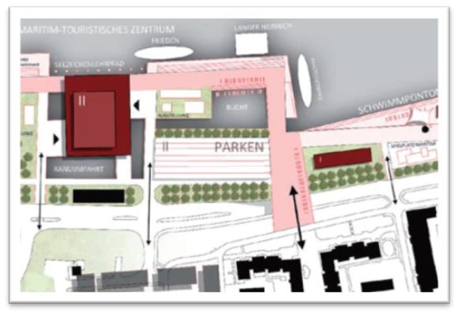
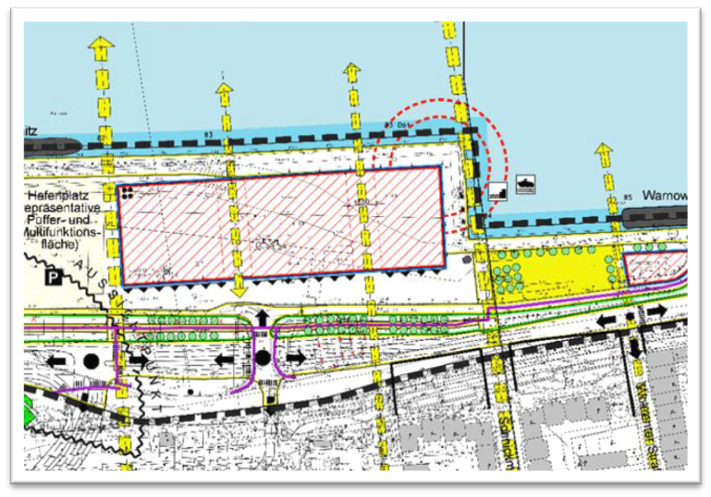
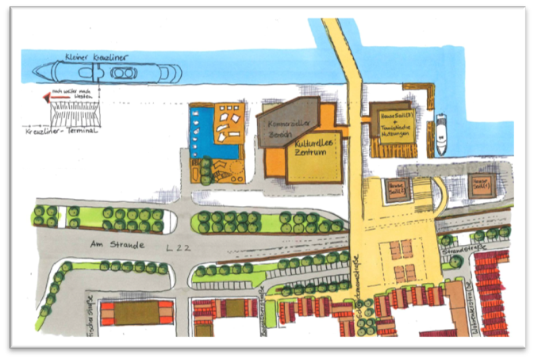
various use interests / existing studies / framework
JOHANN 15.-17.05.2017
Workshop Rostock Package 1 – micro scale – central zone of city harbour

Slide 4
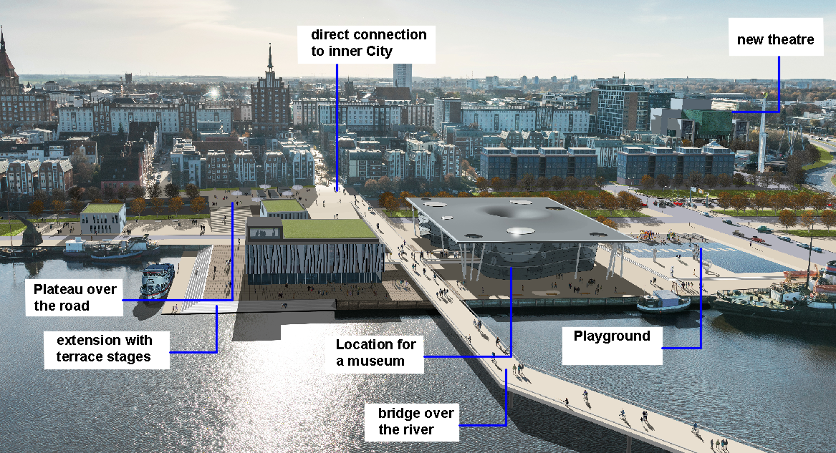
Vision for the city harbour
JOHANN 15.-17.05.2017
Workshop Rostock Package 1 – micro scale – central zone of city harbour

Slide 5
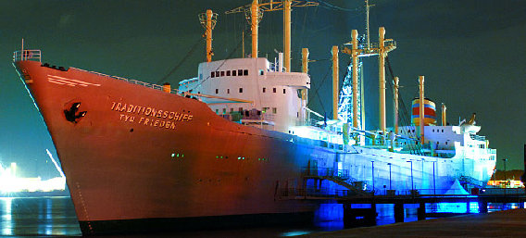
The “Traditionsschiff “ currently contains the shipbuilding museum. It´s located in
Rostock's district “Schmarl”.
In September there will be a public decision about its transfer to the city harbour
and thus on the location of the planned maritime science center
JOHANN 15.-17.05.2017
Workshop Rostock Package 1 – micro scale – central zone of city harbour

Slide 6
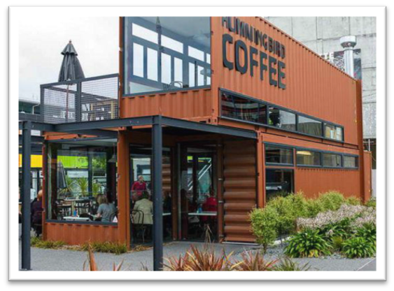
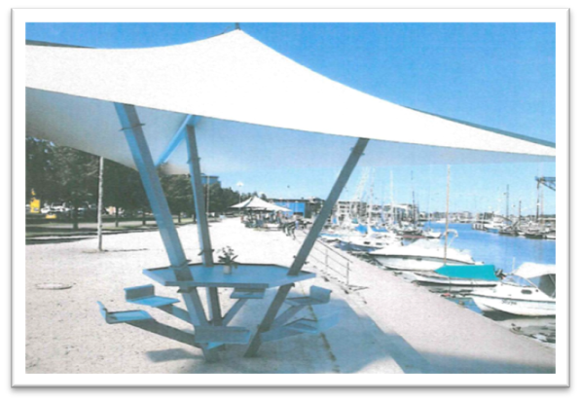
some suggested measures for short-term revitalization of city harbour
example for container modules for temporary uses in the area “Christinenhafen”
establishment of resting places
temporary sport field (e.g. for Beachvolleyball, Streetball or Streetsoccer)

Slide 7
Questions for the Workshop
What are the pros and cons of this visionary development?
How could the necessary terminal for the small cruise ships and the ’Traditionschiff’ possibly be integrated?
How the ’Christinenhafen’ can be changed into a vivid and upgraded place in short term?
…so that cruise liner passengers arrive already in an attractive environment before any Visions are realized.
Which should be the guidelines for architectural qualities in the city harbour?
Workshop Rostock Package 1 – micro scale – central zone of city harbour
anke.grewe@rostock.de
JOHANN 15.-17.05.2017
Notes:
How can the public and restricted areas (guest areas) be arranged sensibly?
How and where stay‑quality can be created for non-paying visitors?
How can the terminal be also used outside of the cruise season?
What are the suggested solutions for the parking lot problems?
How can the functional relations between city, harbour and water be improved?

